Slide 1
Ventilatory management of ALI/ARDS
CS EM R2 박시열

Slide 2
Important pathophysiology
Parenchymal consolidation concentrated in dependent lung regions
Non-de pendent lung relatively spared
Application of normal tidal volumes can lead to overdistension of the small normally aerated lung
Failing to recruit consolidated dependent regions

Slide 3
Important pathophysiology
Ventilator induced lung injury
  oxygen toxicity
  Overdistension
    Barotrauma
    Inflammation
Maintain adequate gas exchange and avoid ventilator induced lung injury

Slide 4
Adequate gas exchange
- Oxygen
High concentrations of inspired oxygen should be
  cellular toxicity
  reabsorption atelectasis
SaO2 > 90%
  Haemodynamic compromise? Lower SaO2 is acceptable
No specific FiO2 thresholds
  Decrease below 0.6 as quickly as possible

Slide 5
Adequate gas exchange
- Oxygen
Alveolar recruitment
  Extrinsic PEEP
  Increasing (I:E) ratio
  Others

Slide 6
Adequate gas exchange - CO2
Protective ventilation may induce hypercapnia(permissive hypercapnia)
PaCO2 levels of 2–3 times normal seem to be well tolerated for prolonged periods
  no data of degree of respiratory acidosis that is safe

Slide 7
Avoidance of ventilator induced lung injury
Traditional mechanical ventilation
  volume cycled, Vt 12 ml/kg,
  PEEP guided by FiO2, normal PaCO
  Enhance lung injury
Protective ventilatory strategy
  Vt <6 ml/kg, permissive hypercapnia
  pressure limited ventilatory mode with PIP limited to <40 cm H2O

Slide 8
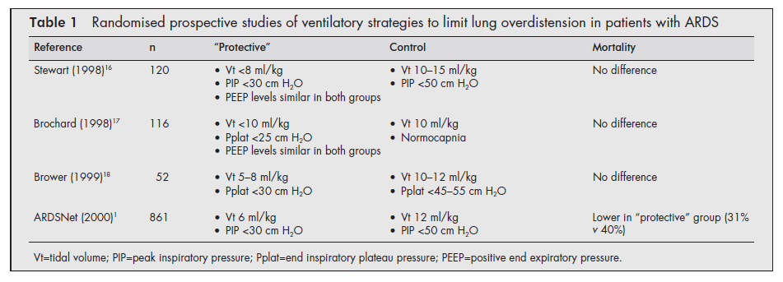

Slide 9
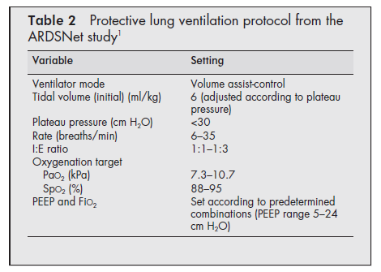

Slide 10
PEEP
Improves oxygenation
  Providing movement of fluid from the alveolar to the interstitial space
  recruitment of small airways and collapsed alveoli
  Increase in functional residual capacity (FRC).
  Cyclical collapse and low volume lung injury is prevented
Use high level such as 15 cm H2O

Slide 11
Recruitment manoeuvres
Recruitment manoeuvres may be more effective in patients ventilated with relatively low levels of PEEP
Increasing intrathoracic pressure and therefore the risk of barotrauma and cardiovascular instability

Slide 12
Recruitment manoeuvres
BiPAP
APRV
Prone ventilation
High frequency ventilation

Slide 13
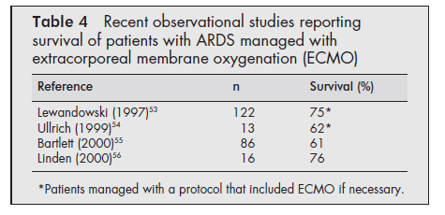
ECMO
Benefit in neonatal ARDS
Several centres have recently reported observational studies showing high survival rates in adult patients

